Slide 1
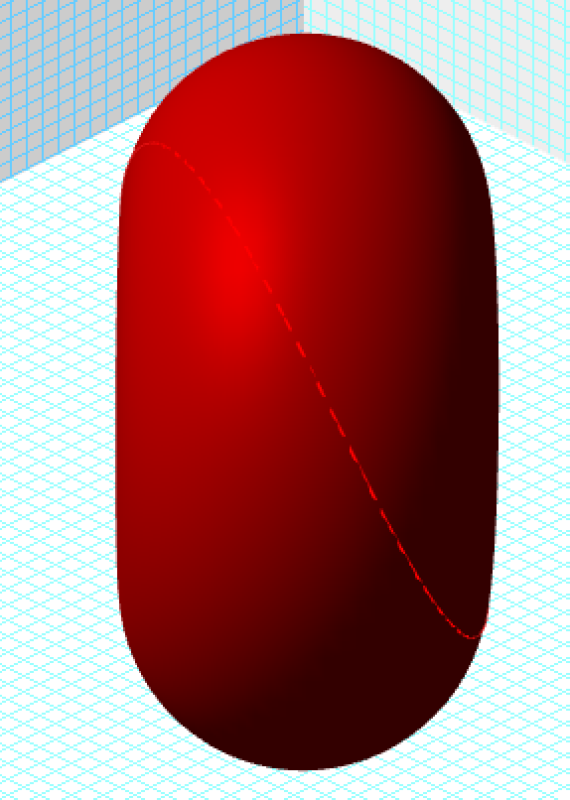
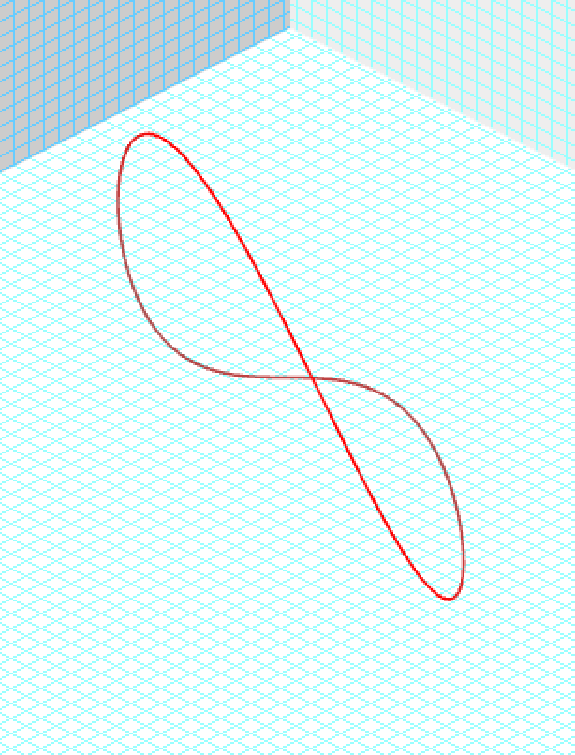
Quantum Vortex Electron Model side view Gamma =1 Beta=0

Slide 2
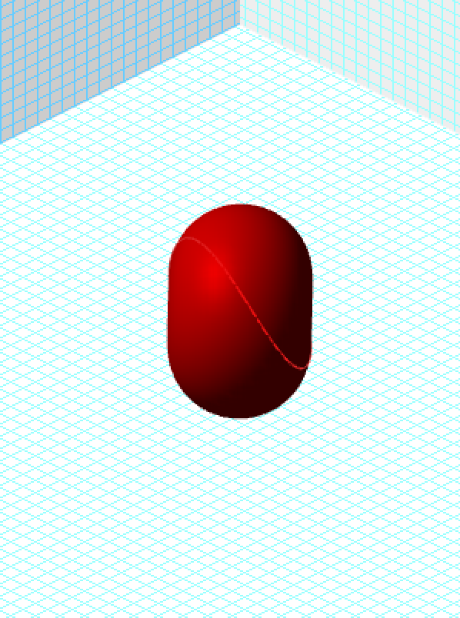
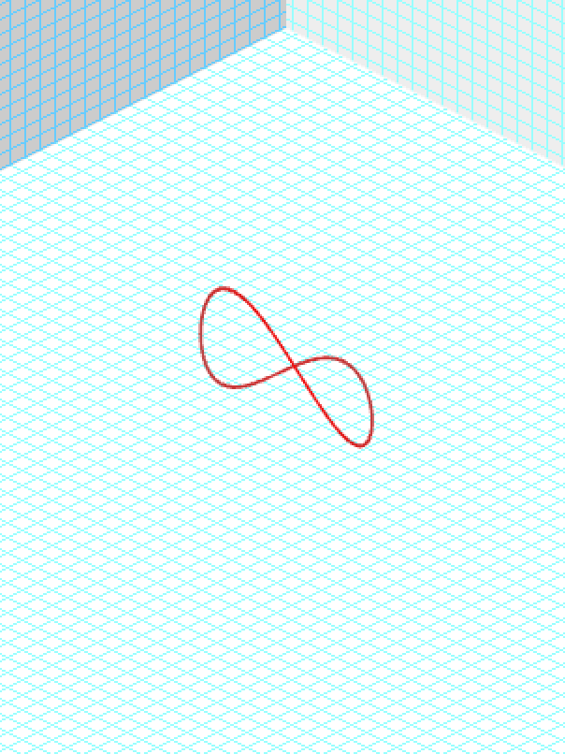
Gamma = 1.99 Beta = .86

Slide 3
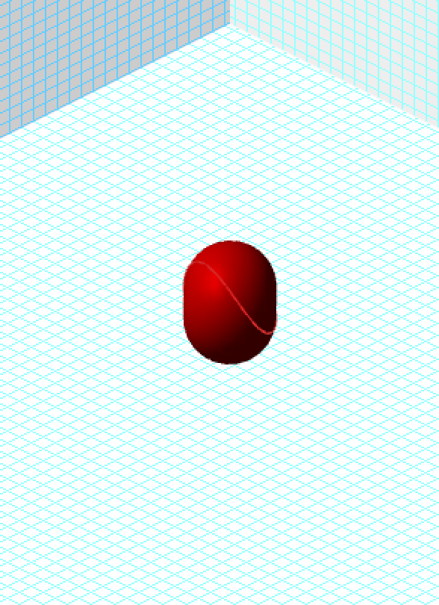
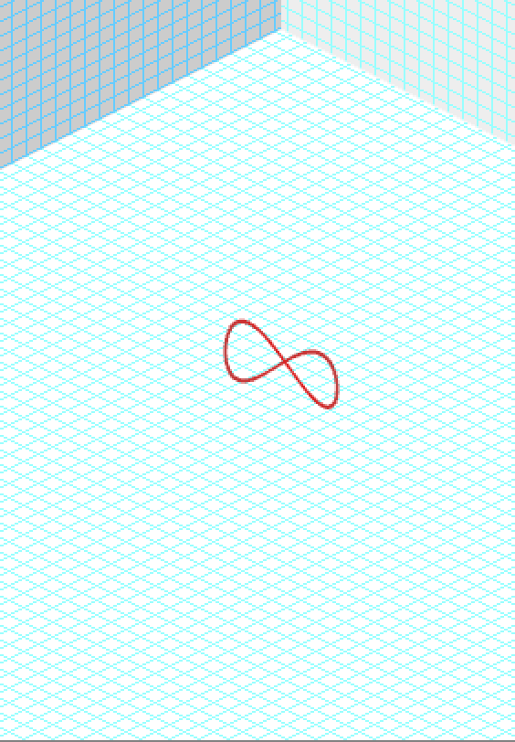
Gamma = 2.98 Beta = .94

Slide 4
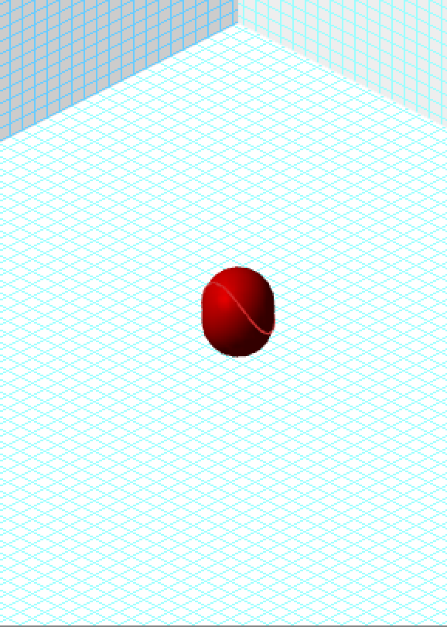
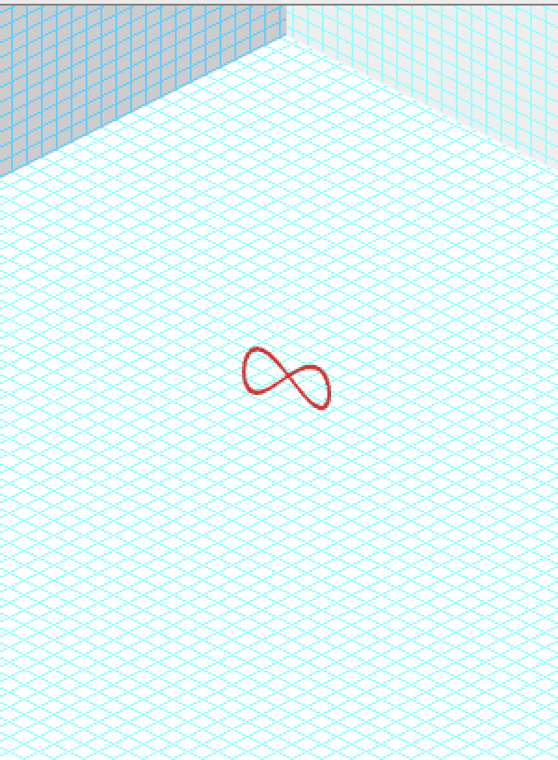
Gamma = 3.97 Beta = .97

Slide 5
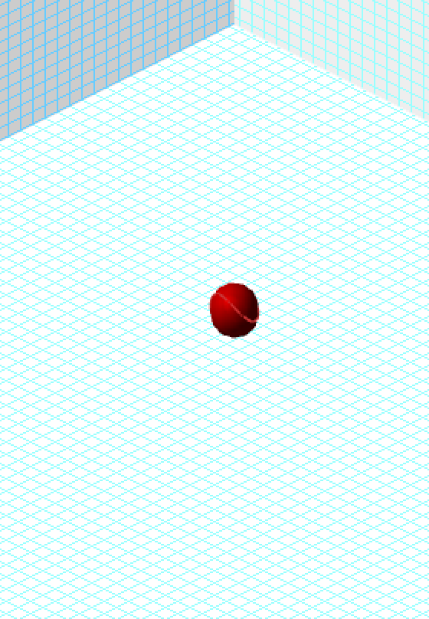
Gamma = 5.95 Beta=.986

Slide 6
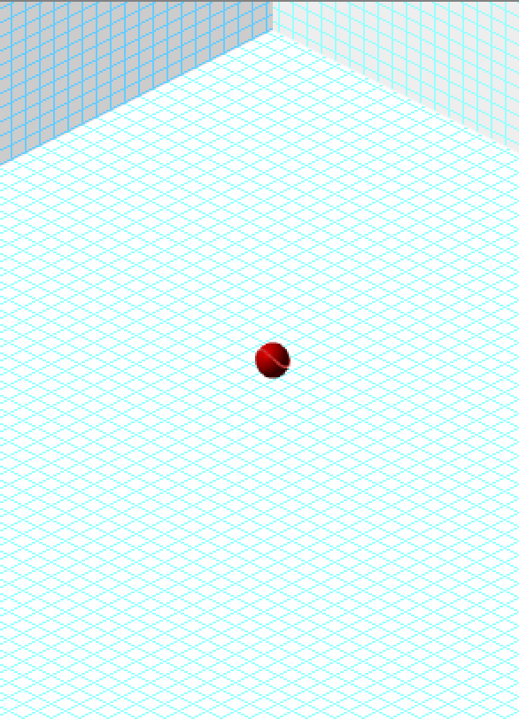
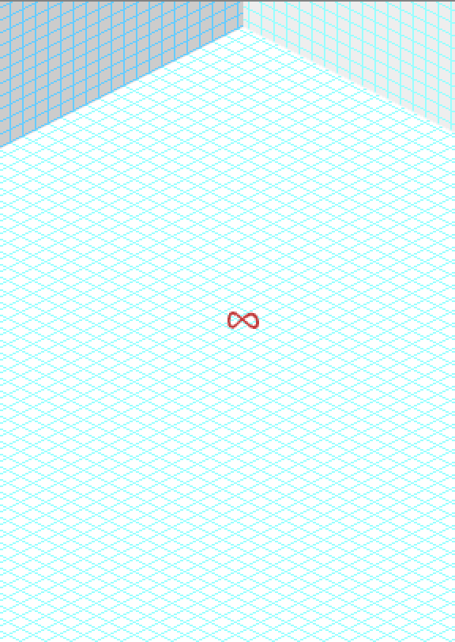
Gamma = 10 Beta = .995

Slide 7
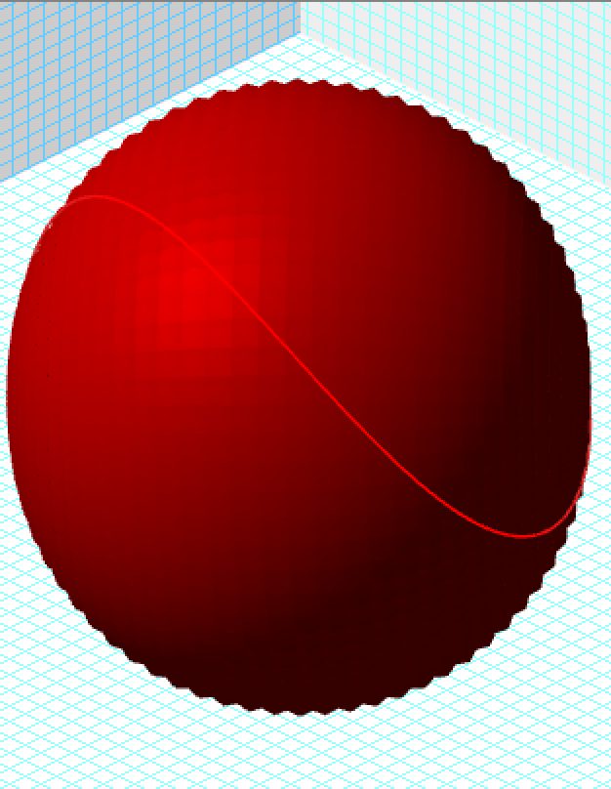
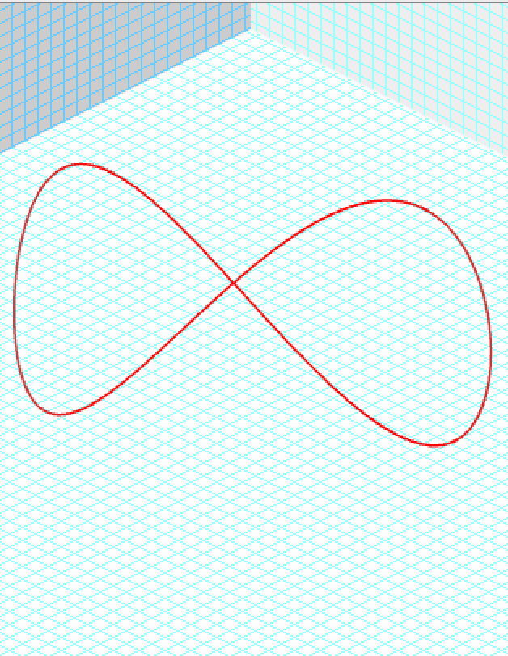
Gamma = 10 Beta=.995 Magnified

Slide 8
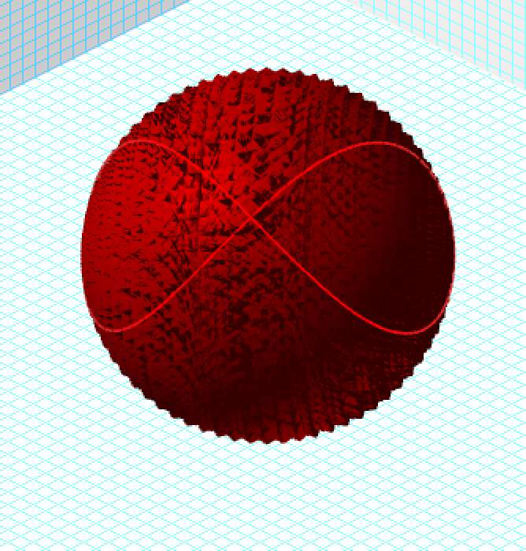
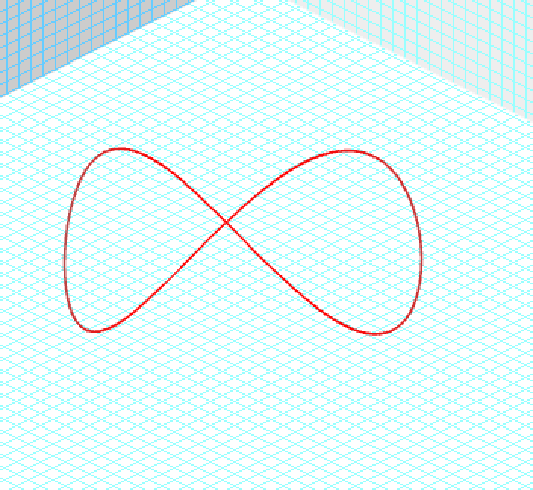
Gamma = 100 Beta=.99995 Magnified. Quantum trajectory is on the surface of a sphere.

Slide 9
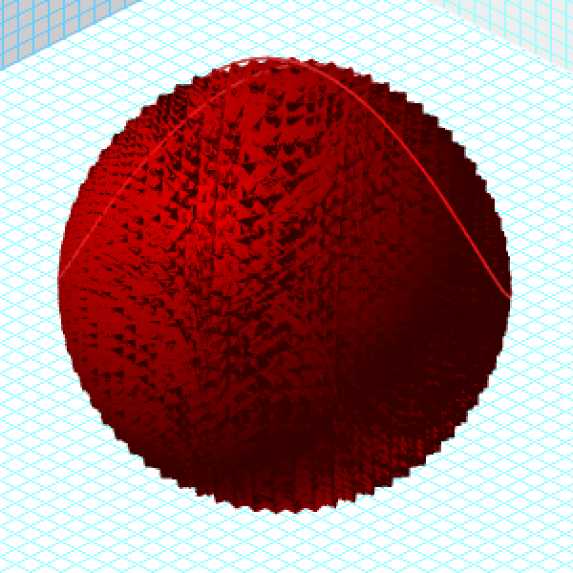
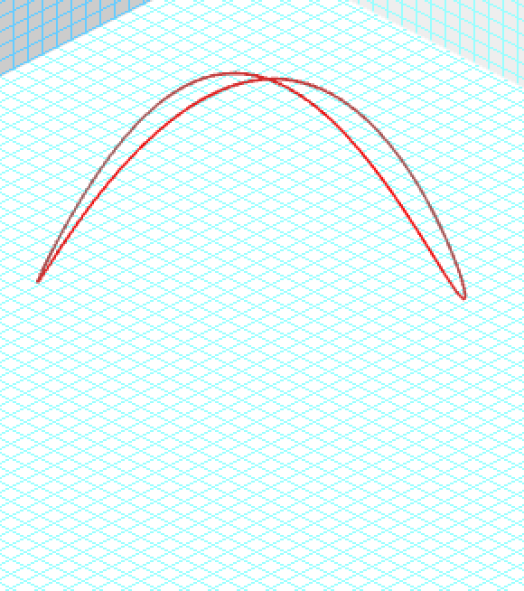
Gamma = 100 Beta - .99995 Magnified. Quantum trajectory is on the surface of a sphere.

